Slide 1
IoT based monitoring and control system for home automation
AKASH S-(202IT107)
MANIRATHINAM K-(202IT167)
INFORMATION TECHNOLOGY

Slide 2
Abstract
The project proposes an efficient implementation for IoT (Internet of Things)
used for monitoring and controlling the home appliances via World Wide Web.
Home automation system uses the portable devices as a user interface. They can
communicate with home automation network through an Internet gateway, by
means of low power communication protocols like Zigbee, Wi-Fi etc. This project
aims at controlling home appliances via Smartphone using Wi-Fi as
communication protocol and raspberry pi as server system. The user here will
move directly with the system through a web-based interface over the web,
whereas home appliances like lights, fan and door lock are remotely controlled
through easy website. An extra feature that enhances the facet of protection from
fireplace accidents is its capability of sleuthing the smoke in order that within the
event of any fireplace, associates an alerting message and an image is sent to
Smartphone.

Slide 3
Abstract Cont.
The server will be interfaced with relay hardware circuits that control
the appliances running at home. The communication with server allows the user to select the appropriate device. The communication with server permits the user to pick out the acceptable device. The server communicates with the corresponding relays. If the web affiliation is down or the server isn't up, the embedded system board still will manage and operate the appliances domestically. By this weprovide a climbable and price effective Home Automation system.
Keywords: Raspberry Pi, LDR, MQ2 Sensor, SMS, GSM, Embedded Web Server.

Slide 4
Problem Statement
There is a great energy crisis in current situation
of our country. Moreover, people have become
negligent in proper utilization of the available
energy. People often forget to turn off the light
sources and other home appliance while staying out
from home. Even in those situations, application of
home automation makes it possible to control them
from a distant place in easy way with our smart
phone.
People are constantly running from place to place,
working to accomplish everything on our never-
ending “to-do” list. Because of the home automation
system, we never have to worry about opening the
door, switching off the appliances and so on. In
short, we can save precious time and experience
more daily productivity

Slide 5
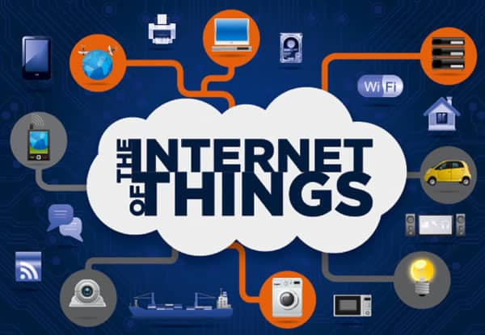
Existing Solution to the Problem Addressed
Existing System
• The existing system for controlling home
appliances is either a manual or remote control
process.
• Manually, home appliances like Light, fan,
etc are controlled by human beings.
• Lot of energy wastage.
• Time consumption.
• Lot of wastage in electricity.
• It is outdated now.
• Makes use of arduino and GSM.

Slide 6
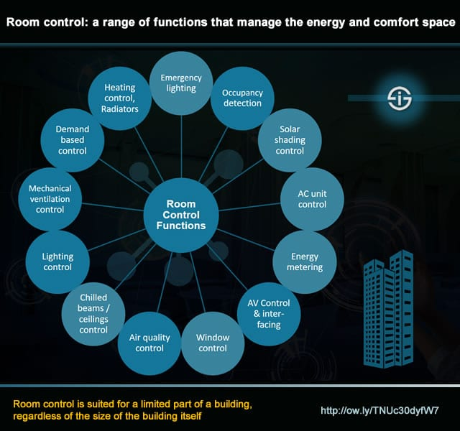
Proposed Solution to the Problem Addressed
Proposed System
• The proposed system is an IOT Based
technology used for operating home appliances using
android phone.
• Smart Home -Improves the standard of
living at home.
• Control Fan through the mobile application.
• Using vibration sensor and fire sensor.
• Uses GSM and Arduino

Slide 7
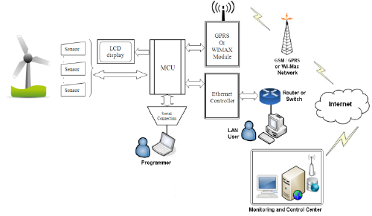
System Design and Implementation
Modules Description:
System analysis uses various types of information
systems to support many processors needed to carry
out their business function. Each of these information
systems has a particular purpose, and each have a life
of its own. This “life of its own “concept is called the
System Development Life Cycle.

Slide 8
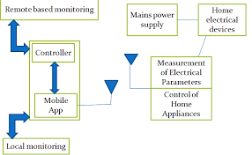
Block Diagram

Slide 9
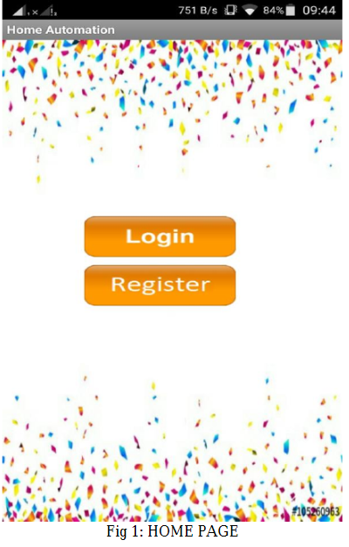
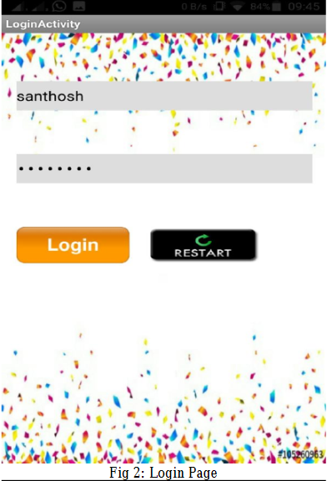
Effective utilization of the Modern Tool & Cloud

Slide 10
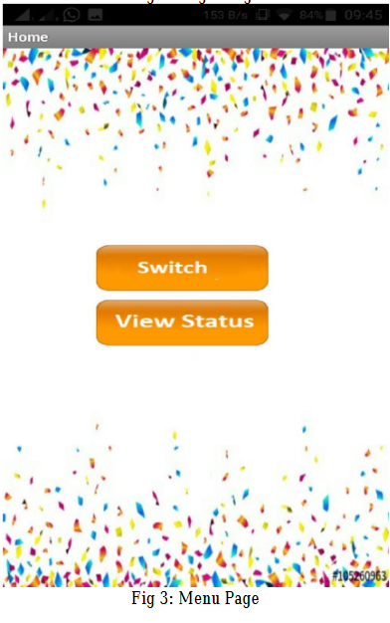
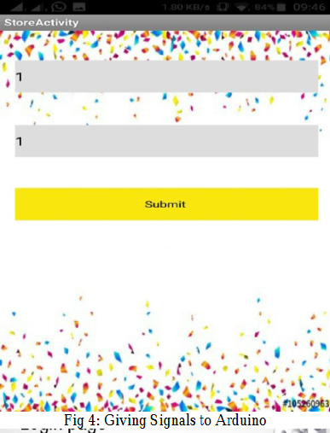
Technology stack & use case

Slide 11
Analysis of Results & Discussions
By using this application we can control home
appliance. This have been implemented using
multiple ways such as The Internet, electrical switch,
and Graphical User Interface (GUI). By using phones
and tablets we can reduce the cost. The system is
suitable for remotely controlling the appliances.
Here, we have introduced the event of a home
management and security system exploitation using
Arduino and Internet of Things technology. The
system is suitable for real-time home safety
monitoring and controlling the home appliances.

Slide 12
Cost Benefit Analysis (List of Components / Service Used)
S.No | Component Name | Specification (IC number or Range or Value) | Unit Cost | Total Cost
1 | Micro Controller | Arduino |  | 1800
2 | Regulated Power Supply | 230AC-5V |  | 100
3 | Display | LCD Display |  | 1000
4 | Phone | Android smart phone |  | ------
5 | Sensors | Vibration, fire |  | 200

Slide 13
References
[1]. Sahani, M.; Kumar Rout, S.; Mandal, A., "Remote monitoring in home automation using microcontroller, "Communications and Signal Processing , 2014International Conference April 2014
[2]. T. Lin, H. Zhao, J. Wang, G. Han, and J. Wang, “An embedded Webserver for equipment,” in Proc. 7th Int. Symp. Parallel Architectures, Algorithms and Networks, May 10–12, 2004, pp. 345–350.
[3]. A.Ramakrishnan, “16 bit embedded Web server,” in Proc. 2004, IEEE Sensors for Industry Conf., 2004, pp. 187–193
[4]. RTOS Evaluation Project, ―What makes a good RT OS, Dedicated Systems Experts, 2001. [Online]. Available: www.dedicatedsystems.com.

